Slide 1
“Overview of Horovod”
How Deep Learning training works
Distributed computing
Horovod
Why Horovod
Steps in Horovod to achieve distributed computing
Horovod addition in ADM- Keras Classifier

Slide 2
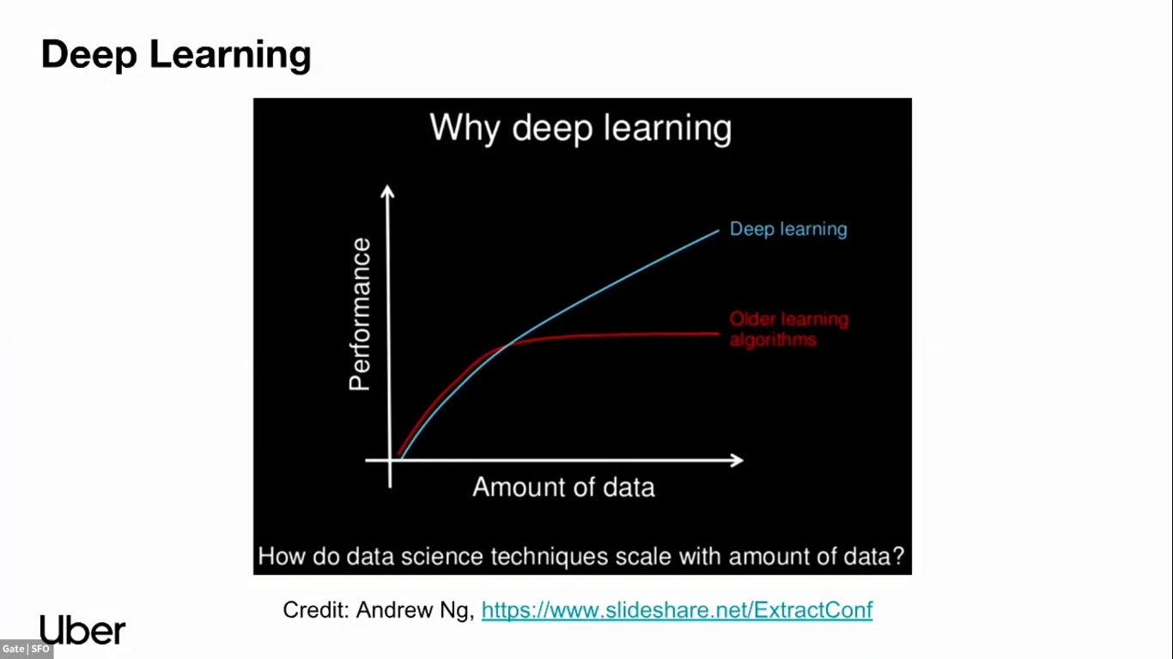

Slide 3
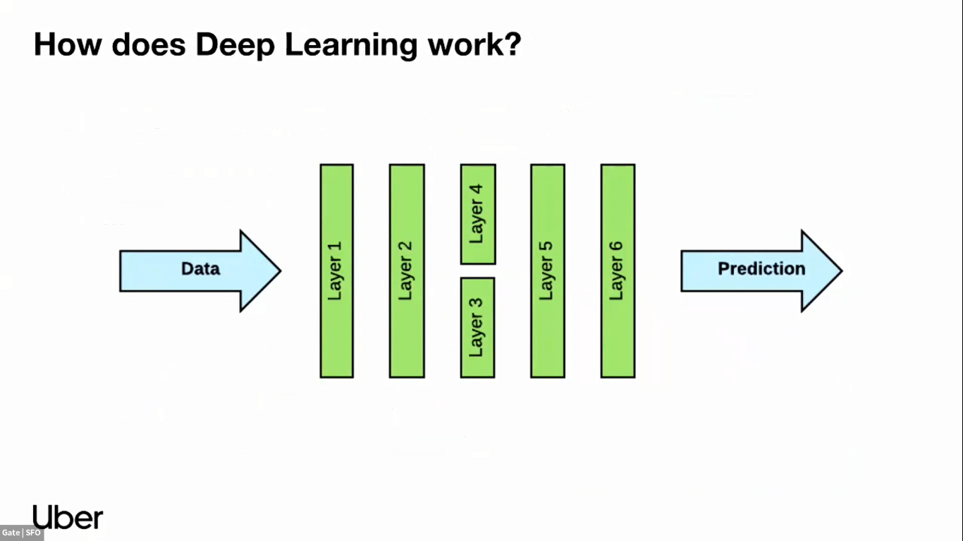

Slide 4
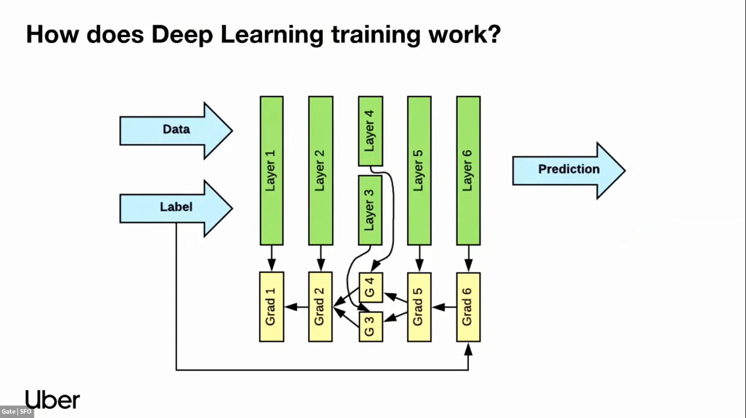

Slide 5
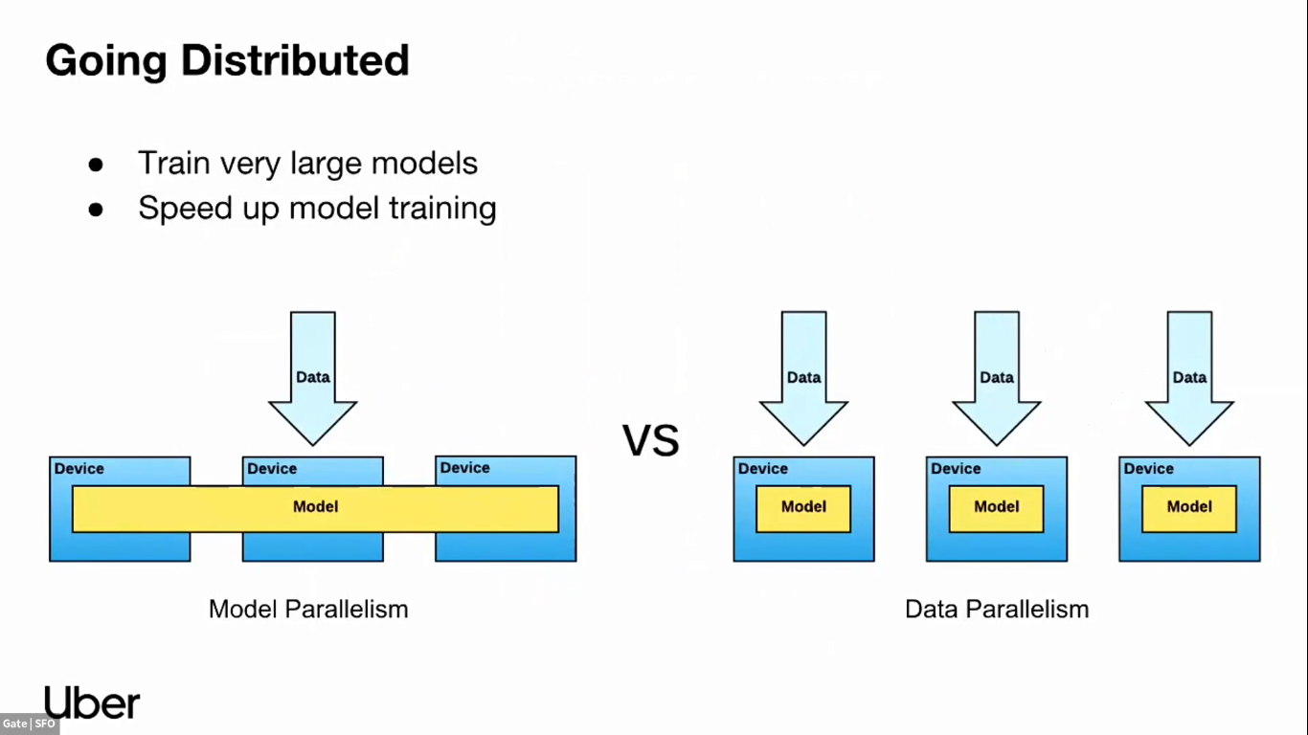

Slide 6
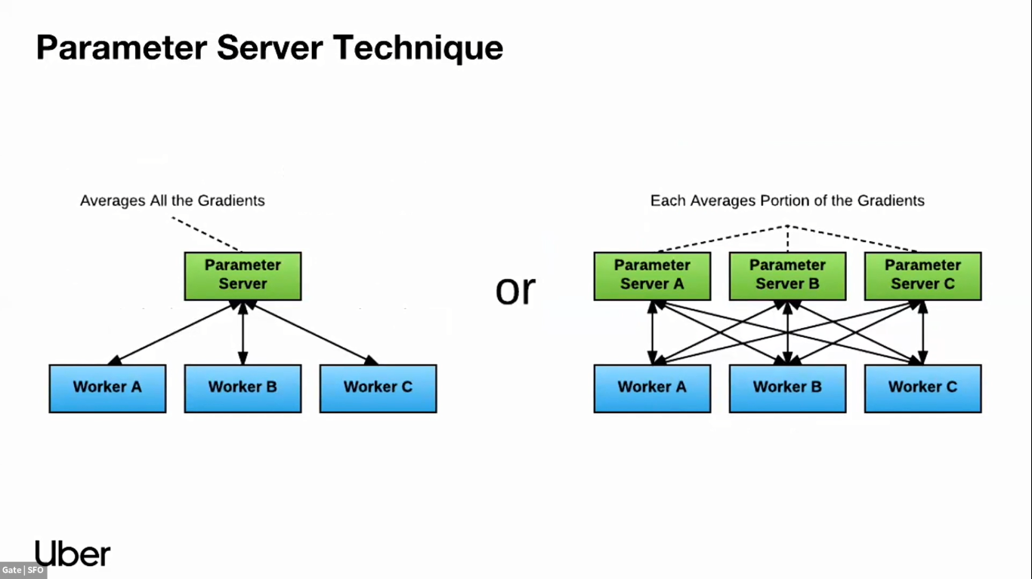

Slide 7
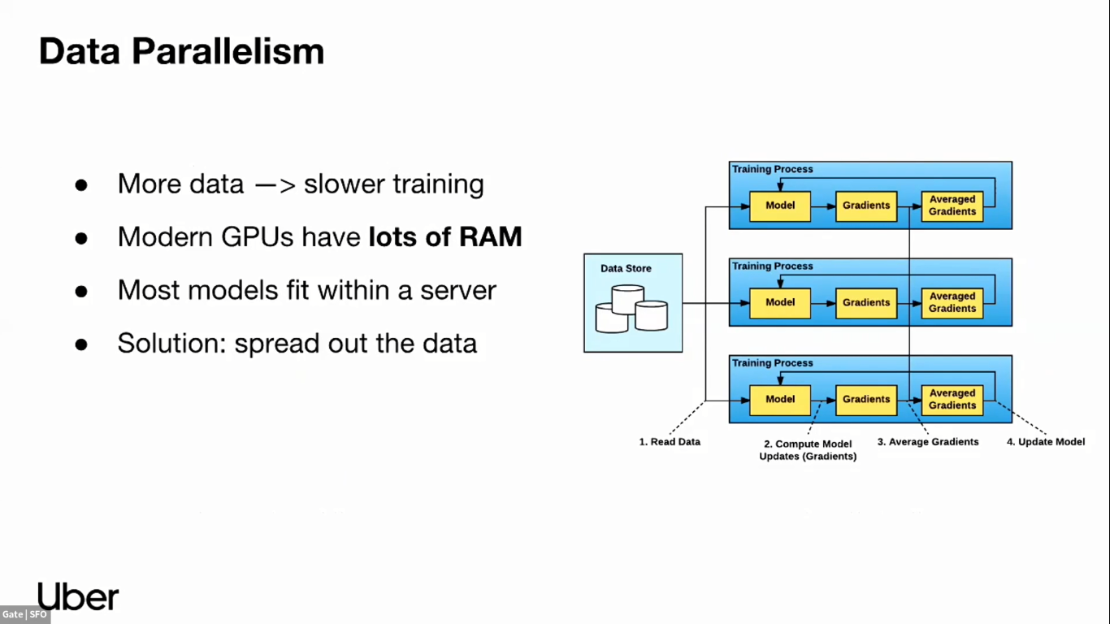

Slide 8
Why Horovod…?
Problem in Deep Learning
One of the biggest problems with Deep Learning models is that they are becoming too big to train in a single GPU.
In order to train models in a timely fashion, it is necessary to train them with multiple GPUs.
Goals:
-- Fast and easy distributed deep learning.
Separation of concern:
Infrastructure engineer optimize distributed deep training performance for their environment (server, networking, container, hardware).
Machine Learning engineer focus on making great models with the deep learning framework they like to use.

Slide 9

Horovod
Horovod is a distributed deep learning training framework introduced by Uber for TensorFlow, Keras, PyTorch, and Apache MXNet. The goal of Horovod is to make distributed deep learning fast and easy to use.

Slide 10
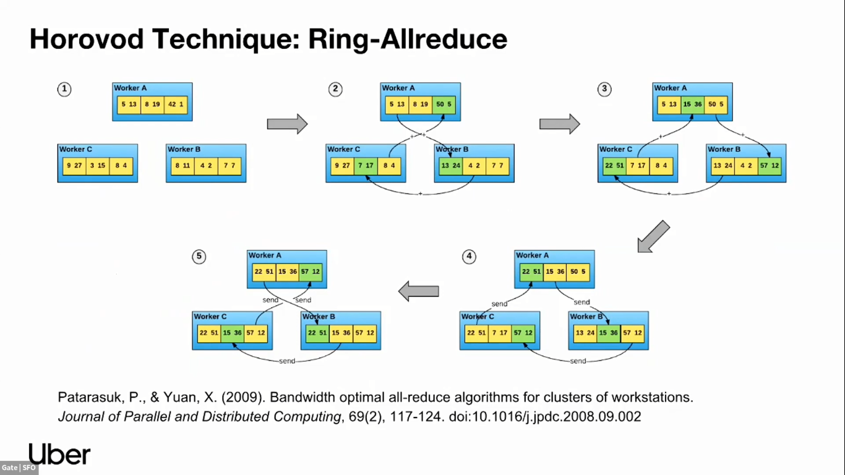

Slide 11
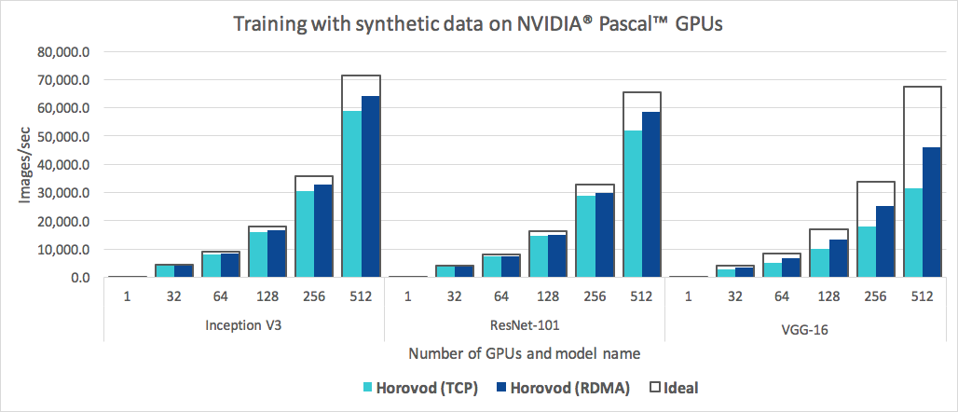
In addition to being easy to use, Horovod is fast. Below is a chart representing the benchmark that was done on 128 servers with 4 Pascal GPUs each connected by RoCE-capable 25 Gbit/s network:
Horovod achieves 90% scaling efficiency for both Inception V3 and ResNet-101, and 68% scaling efficiency for VGG-16

Slide 12
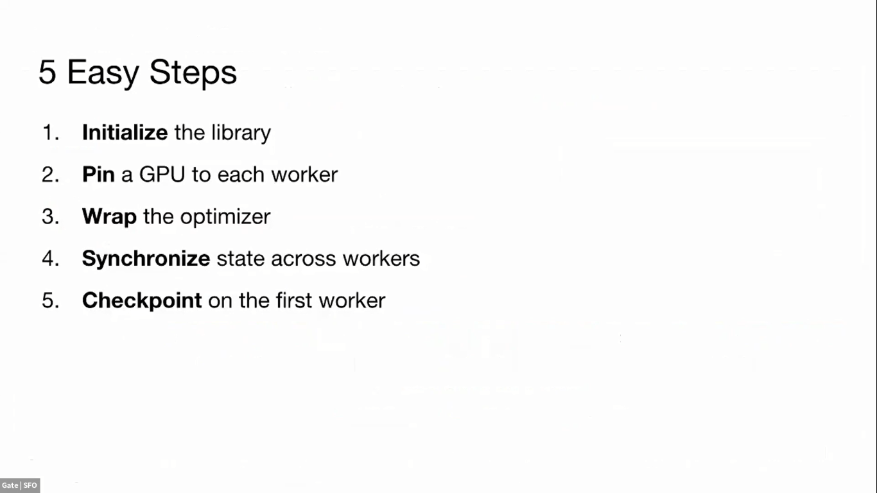

Slide 13
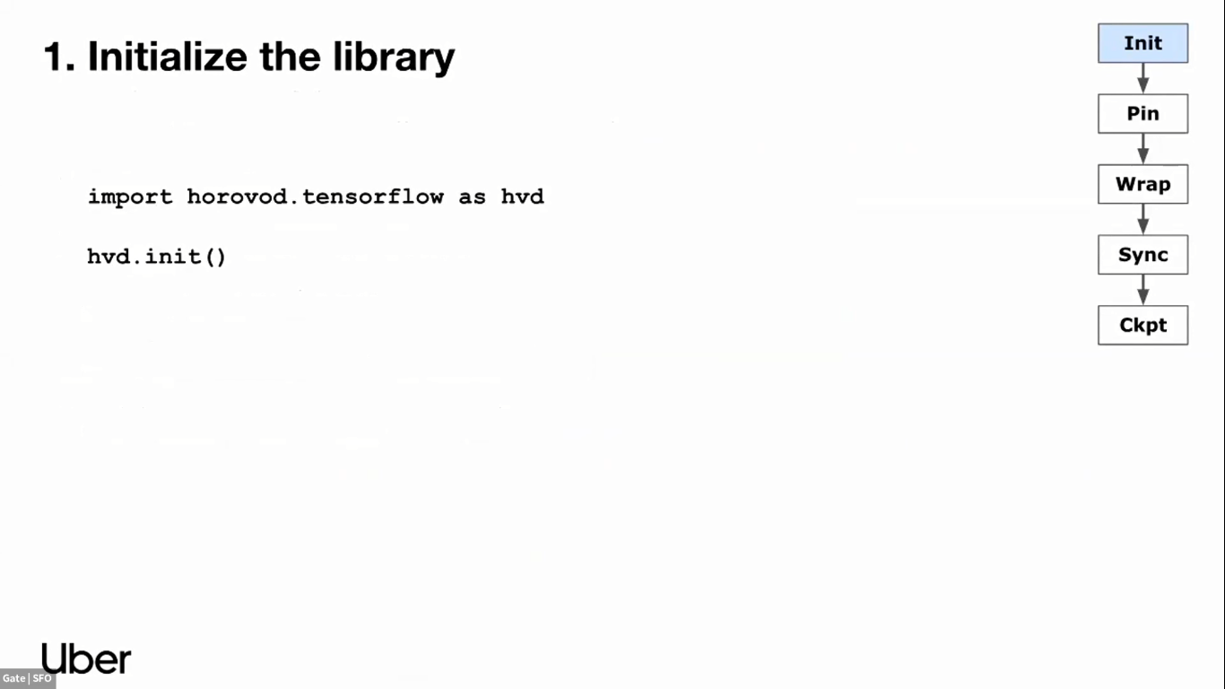

Slide 14
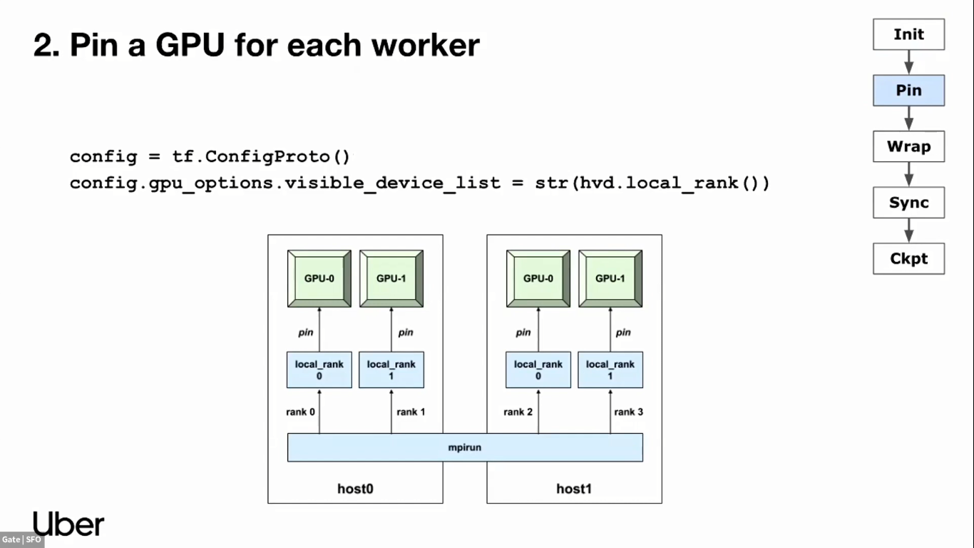

Slide 15
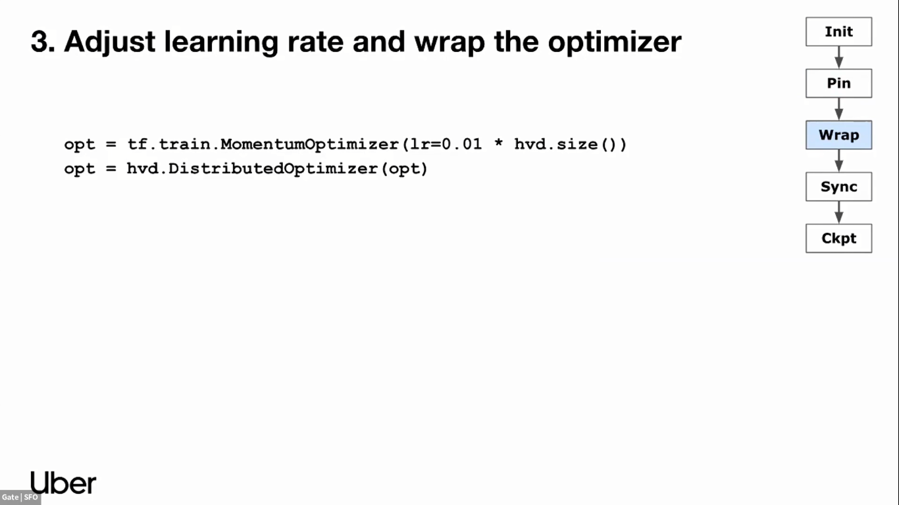

Slide 16
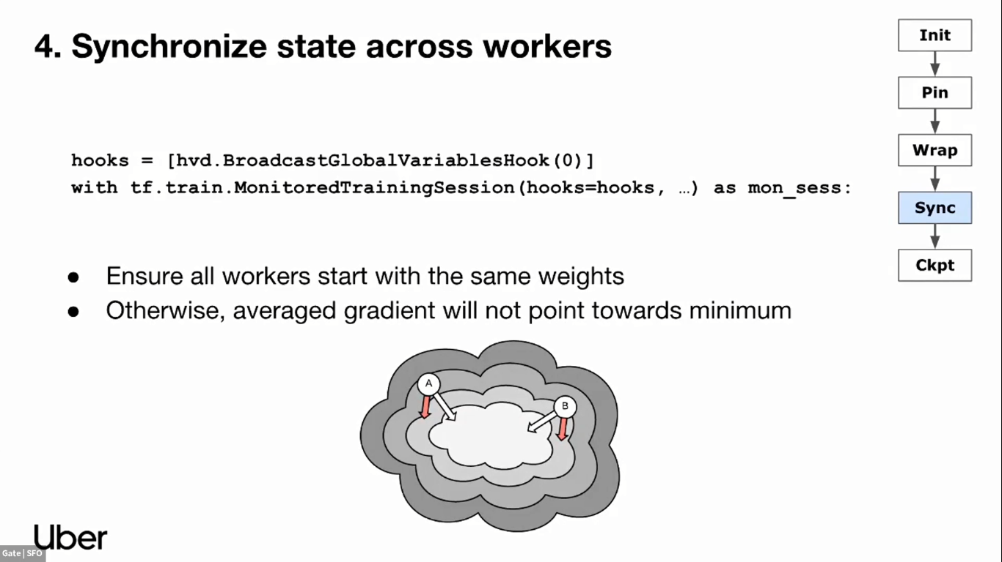

Slide 17
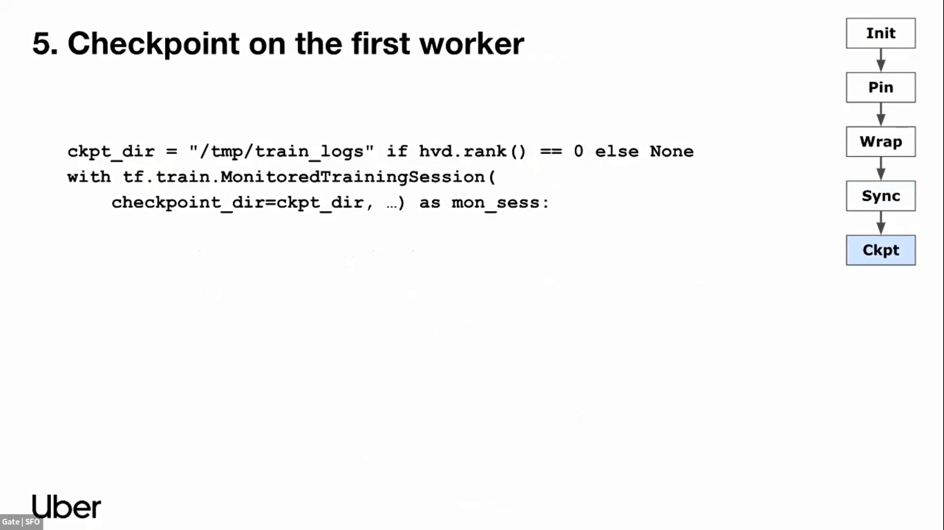

Slide 18
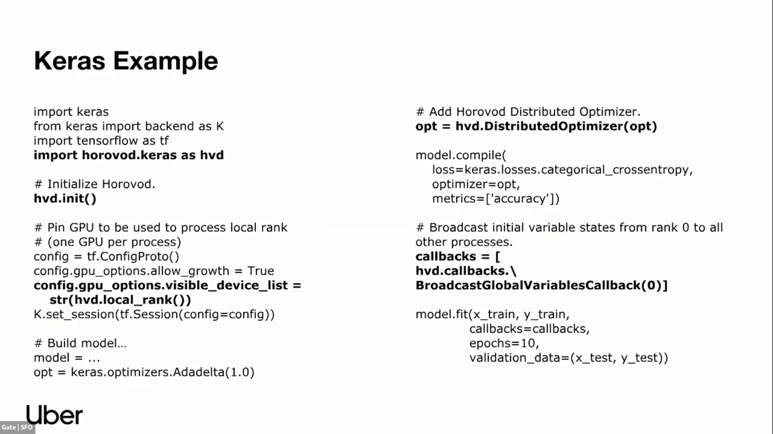

Slide 19
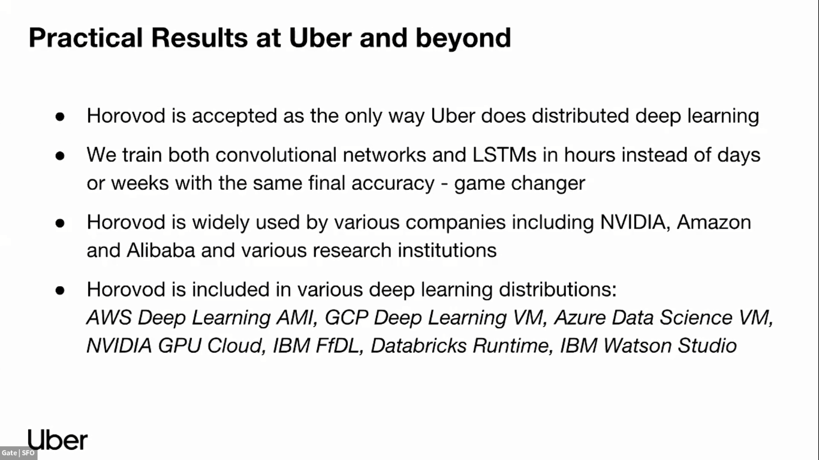

Slide 20
References
https://eng.uber.com/horovod/
https://horovod.readthedocs.io/en/stable/
https://leimao.github.io/blog/Data-Parallelism-vs-Model-Paralelism/

Slide 21
Thank You

